Slide 1
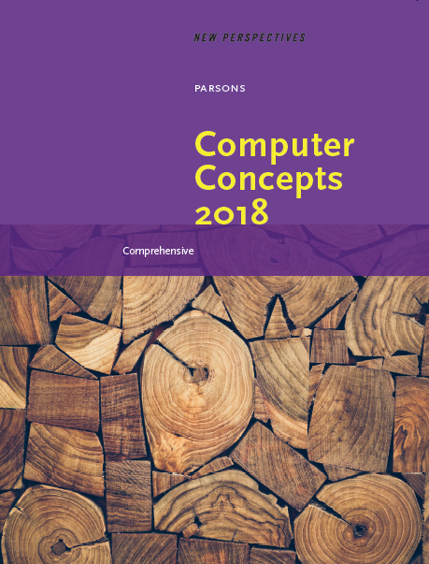

Computer Concepts 2018
Module 6
Software
Copyright © 2019 Cengage. All rights reserved.

Slide 2
Module Contents
Section A: Software Basics
Section B: Operating Systems
Section C: Apps and Applications
Section D: Productivity Software
Section E: File Management Utilities

Slide 3
Section A: Software Basics
Essentials
Distribution
Software Licenses
Fake and Pirated Software

Slide 4
Section A: Objectives (1 of 2)
Draw a hierarchical diagram that illustrates the three main categories of software and their subcategories
State four best practices for obtaining software
Distinguish between software updates and upgrades
List four pricing models commonly used in the software industry
Explain why most software is licensed
Describe the difference between proprietary software and public domain software

Slide 5
Section A: Objectives (2 of 2)
List and describe three types of commercial software licenses
Create a chart comparing freeware, demoware, and shareware
Name two popular open source software licenses
List four ways to avoid fake mobile apps

Slide 6
Essentials (1 of 7)
When searching for new software, it helps to have a framework of categories
System Software
Operating Systems
For controlling a digital device’s internal operations
Windows, macOS, iOS, Linux, Android, UNIX, and Chrome OS.
Device Drivers
For digital devices to communicate with each other .
Printer Drivers and Video Drivers
Utilities
For file management, security, communications, backup, network management, and system monitoring

Slide 7
Essentials (2 of 7)
Development Software
Programming Languages
For writing programs C Basic, Java, Fortran, C++, C#, Scheme, and Objective-C
Scripting Languages
For writing scripts, creating Web pages, and querying databases
HTML, JavaScript, PHP, Python, Ruby, and SQL
Quality Assurance Tools
For testing software Debuggers, Load Testing, Security Testing

Slide 8
Essentials (3 of 7)
Application Software
Professional Tools
For automating professional activities at work and in the home office
Desktop Publishing, Graphic Design, and Special Effects
Educational Software
For students and teachers engaged in the process of learning in classrooms and at a distance
Tutorials, Courseware, and Learning Management Systems
Personal Finance Software
For managing bank accounts, preparing taxes, retirement planning, and other financial matters
Tax Preparation, Banking Apps, and Loan Calculators

Slide 9
Essentials (4 of 7)
Entertainment Software
For accessing media and playing games
Ebook Readers, Games, Media Players, and Media Editors
Reference Software
For accessing information in specific topic areas
Travel, Sports, Medical, Hobbies, Lifestyle, Maps, News, Weather, and Shopping
Social Media Software
For accessing and working with social media services, such as Facebook and WordPress
Social Analytics, Dashboards, and Marketing

Slide 10
Essentials (5 of 7)
Business Software
For automating core business functions
Accounting, Inventory Management, Billing Databases, Point of Sale, Sales force Management and Estimating
Productivity Software
For automating tasks formerly carried out with legacy technologies, such as pen and paper, typewriters, calculators, and slide Projectors
Word Processors, Spreadsheets, Presentations, Calendars, and Contact Managers

Slide 11
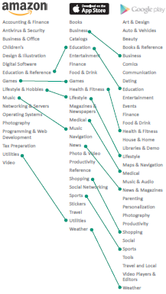
Essentials (6 of 7)
There is no universal standard for categorizing software, but various categorization schemes have many similarities

Slide 12
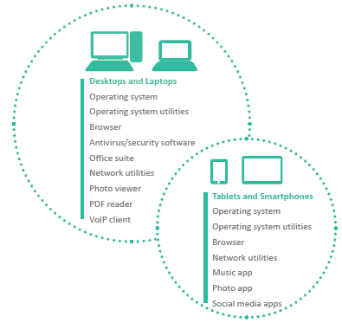
Essentials (7 of 7)
Mobile devices are used differently from desktop and laptop computers, so the configuration of their software is slightly different
Files tend to be stored and retrieved by each app, so users have little need for a utility that allows access to the file management system.

Slide 13
Distribution (1 of 5)
Most consumers obtain software online, where it can be downloaded directly from the developer or from a software aggregator
An executable file contains a computer program that is carried out step-by-step within the microprocessor
Software can contain viruses and other malware, so consumers should download new applications only from trusted sources
Software developers usually have a Web site for distributing software. Well-established developers tend to offer trustworthy products

Slide 14
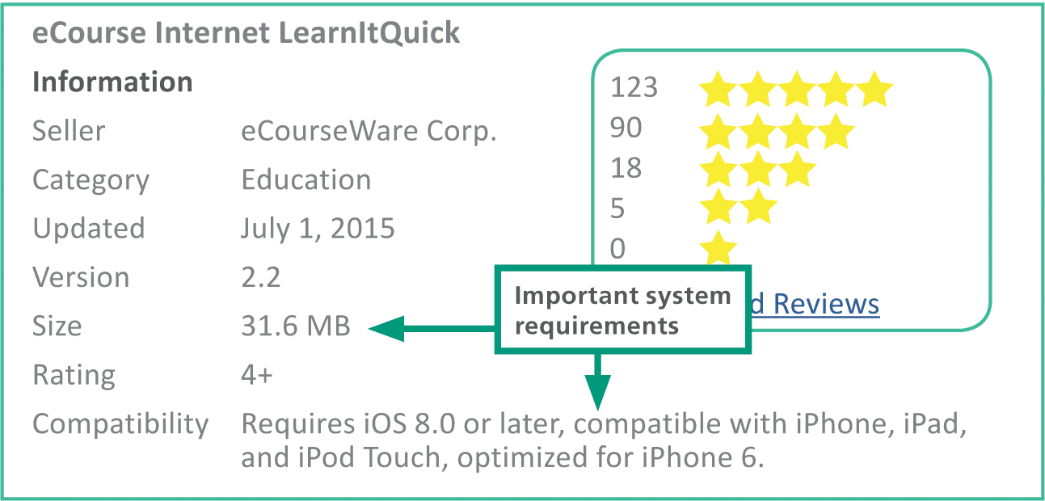
Distribution (2 of 5)
System requirements specify the operating system and minimum hardware capacities necessary for a software product to work correctly

Slide 15
Distribution (3 of 5)
When a new version or edition of a software product is released, it is referred to as a software upgrade
A software update (sometimes called a software patch) is a small section of program code that replaces part of the software currently installed
The term service pack, which usually applies to operating system updates, refers to a set of updates
Updates and service packs are designed to correct problems and address security vulnerabilities

Slide 16
Distribution (4 of 5)
Software can be obtained under a variety of pricing models
One-time purchase – the software remains basically the same as when it was purchased
Subscription – consumers pay a monthly or an annual fee to use software; updates and upgrades are usually included in the pricing
Trial – consumers use a software product during a free trial period
Freemium – provides free use of a stripped-down or basic version of the product but requires payment for upgraded features

Slide 17
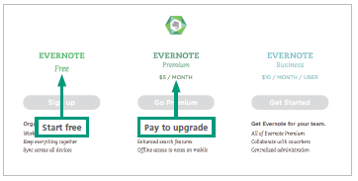
Distribution (5 of 5)

Slide 18
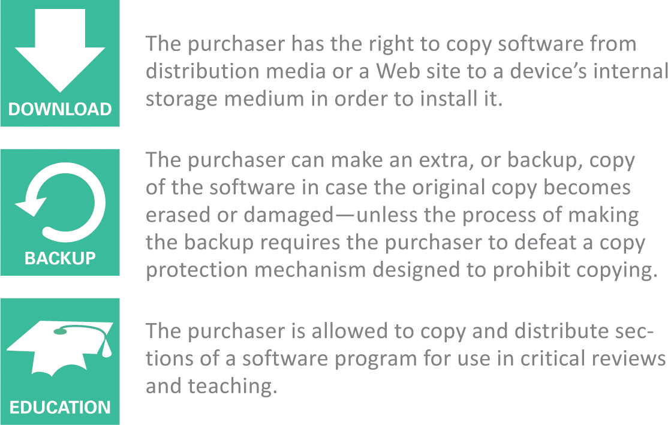
Software Licenses (1 of 9)
A software license, or license agreement, is a legal contract that defines the ways in which a computer program may be used
These licenses are sometimes referred to as EULAs (End User License Agreements)

Slide 19
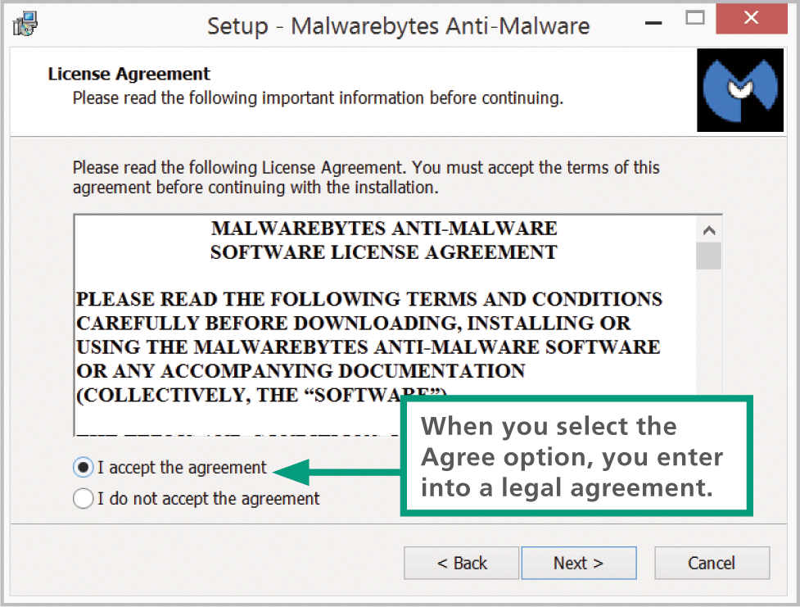
Software Licenses (2 of 9)
License agreements are displayed during the installation process. By clicking the I Agree button, you consent to the terms of the license agreement

Slide 20
Software Licenses (3 of 9)
Public domain software is not protected by copyright because the copyright has expired or the author has placed the program in the public domain, making it available without restriction
Proprietary software has restrictions on its use that are delineated by copyright, patents, or license agreements
Commercial software is usually sold in retail stores or on Web sites. Most commercial software is distributed under a single-user license that limits use to one person at a time

Slide 21
Software Licenses (4 of 9)
A site license is generally priced at a flat rate and allows software to be used on all computers at a specific location
A multiple-user license is priced per copy and allows the allocated number of copies to be used simultaneously

Slide 22
Software Licenses (5 of 9)
Freeware is copyrighted software that—as you might expect—is available for free. It is fully functional and requires no payment for its use
Demoware is proprietary software made available as a trial version. It is distributed for free and often comes preinstalled on new devices
Product activation is a means of protecting software from illegal copying by requiring users to enter a product key or an activation code

Slide 23
Software Licenses (6 of 9)
A hash value is a unique number derived from encoding one or more data sets, such as names, serial numbers, and validation codes
Shareware is copyrighted software marketed under a try-before-you-buy policy. It was conceived as a low-cost marketing and distribution channel for independent programmers

Slide 24
Software Licenses (7 of 9)
Open source software makes uncompiled program instructions—the source code—available to programmers who want to modify and improve the software. Linux is an example of open source software
Two of the most common open source and free software licenses are BSD and GPL

Slide 25
Software Licenses (8 of 9)
The BSD license originated as the Berkeley Software Distribution license for a server operating system
The GPL (General Public License) was developed for a free operating system called GNU. It is slightly more restrictive than the BSD license because it requires derivative works to be licensed

Slide 26
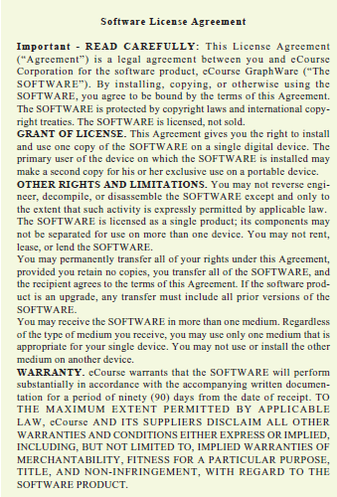
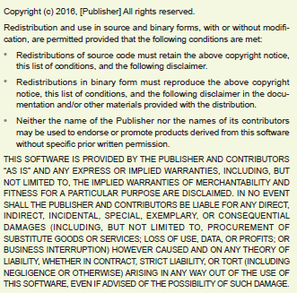
Software Licenses (9 of 9)

Slide 27
Pirated Software (1 of 2)
Software that is illegally copied and sold is referred to as pirated software.
Some unsuspecting consumers have inadvertently obtained pirated software, even when paying full price from a reputable source.
Pirated software may not update properly and is not eligible for authenticated upgrades.

Slide 28
Pirated Software (2 of 2)
The following characteristics could be signs of pirated software:
Software sold at Web sites for prices well below retail
Commercial software offered as a free download from a third-party Web site or Tor server
Software sold in a clear CD-ROM jewel case with no accompanying documentation, license, registration card, or Certificate of Authenticity
Software marked as “Academic” that requires no proof of eligibility
Software marked as “OEM” or “For Distribution Only with New PC Hardware”

Slide 29
Section B: Operating Systems
Operating System Basics
Microsoft Windows
macOS
iOS
Android
Chrome OS
Linux
Virtual Machines

Slide 30
Section B: Objectives (1 of 2)
List and describe four categories of operating systems
Explain the purpose of an operating system kernel and name the operating system kernels that were used to develop Windows and MacOS
List five digital device resources that are managed by the operating system
Define the terms multitasking, multiprocessing, and multithreading
Explain how memory leaks develop and why they are a problem
Give an example of a buffer that is managed by the operating system

Slide 31
Section B: Objectives (2 of 2)
Summarize the strengths and weaknesses of the Windows operating system
Summarize the strengths and weaknesses of macOS
List three ways in which iOS and Android are the same and two ways in which they differ
Explain why Chrome OS is considered a thin client
Provide an example of a situation that would benefit from the use of a virtual machine

Slide 32
Operating System Basics (1 of 13)
An operating system gives your digital device a personality. It controls key elements of the user interface, which includes the visual experience as well as the keyboard, mouse, microphone, or touchscreen that collects user commands
Behind the scenes, the OS is busy supervising critical operations that take place within a device

Slide 33
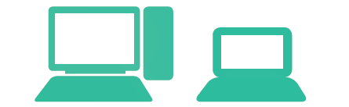
Operating System Basics (2 of 13)
A desktop operating system is designed for a desktop or laptop computer.
The computer you use at home, at school, or at work is most likely configured with a desktop operating system, such as Microsoft Windows, macOS, or Chrome OS.

Slide 34
Operating System Basics (3 of 13)
Key characteristics of desktop operating systems include the following:
Accommodate one user at a time, but allow multiple accounts
Provide local area networking capability
Include file management tools
Run more than one application at a time
Offer a graphical user interface designed for keyboard and mouse input

Slide 35

Operating System Basics (4 of 13)
Operating systems such as iOS and Android are classified as mobile operating systems because they are designed for use on smartphones, tablet computers, and ebook readers.
Key characteristics of mobile operating systems include the following:

Slide 36
Operating System Basics (5 of 13)
Accommodate one user at a time
Provide connectivity to wireless local area networks
Offer a graphical user interface designed for touchscreen input
Include integrated cellular communications

Slide 37

Operating System Basics (6 of 13)
Computers that are deployed as Web servers, or as servers for files, applications, databases, or email, generally use a server operating system designed for distributed networks accessed by many simultaneous users.
Linux, UNIX, Windows Server, and macOS Server are examples of popular server operating systems with the following characteristics:

Slide 38
Operating System Basics (7 of 13)
Accommodate multiple simultaneous users
Include sophisticated network management and security tools
Provide a utilitarian user interface

Slide 39
Operating System Basics (8 of 13)
During the boot process, the OS kernel is loaded into RAM. A kernel provides essential operating system services, such as memory management and file access
In the context of digital devices, the term resource refers to any component that is required to perform work

Slide 40
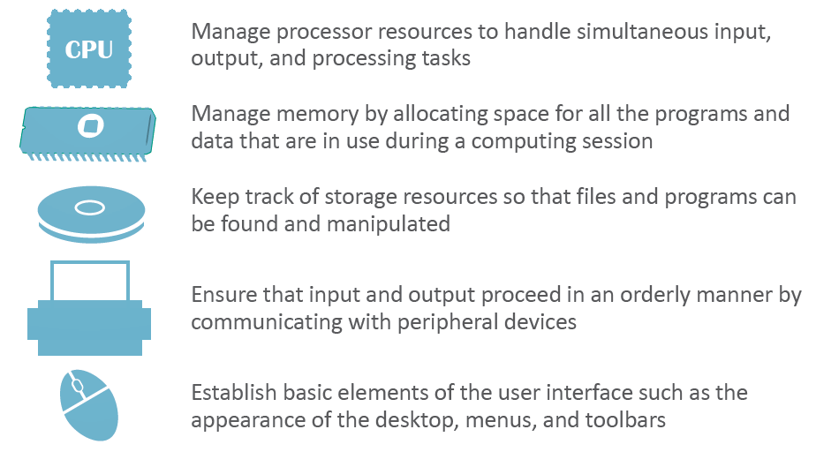
Operating System Basics (9 of 13)

Slide 41
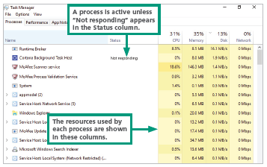
Operating System Basics (10 of 13)
Many activities—called processes—compete for the attention of a device’s microprocessor
To manage all these competing processes, an operating system must ensure that each process receives its share of attention from the microprocessor

Slide 42
Operating System Basics (11 of 13)
Depending on the capabilities of the operating system and computer hardware, processes can be managed by multitasking, multithreading, and multiprocessing
Multitasking – provides process and memory management services that allow two or more tasks, jobs, or programs to run simultaneously
Multithreading – allows multiple commands, or threads to run simultaneously
Multiprocessing – a capability that supports a division of labor among all the processing units

Slide 43
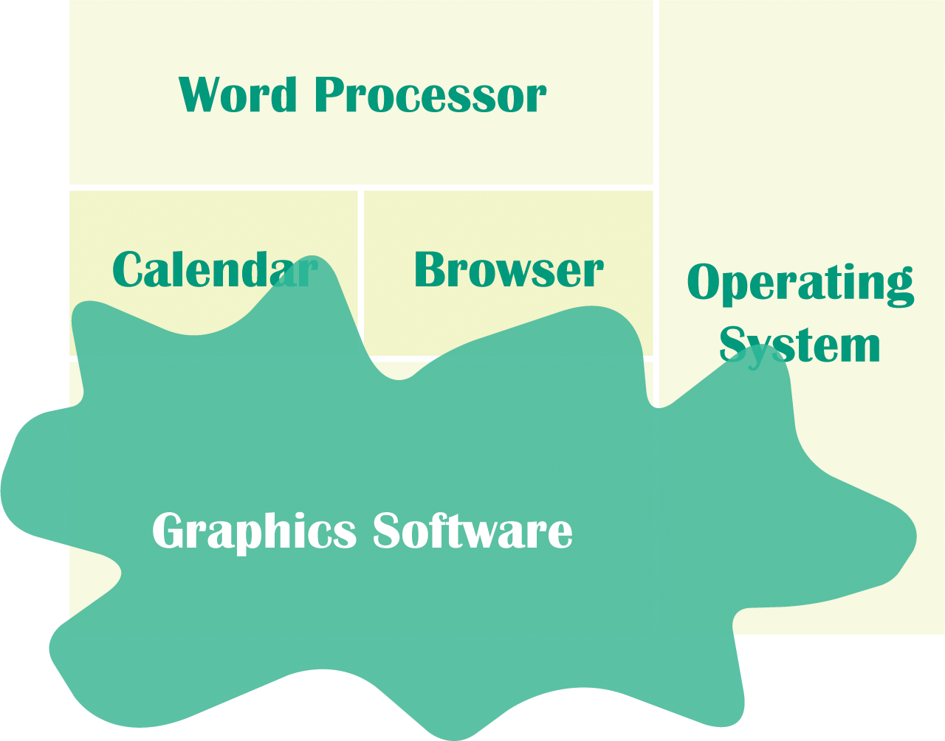
Operating System Basics (12 of 13)
When you want to run more than one application at a time, the OS has to allocate specific areas of memory for each. Sometimes application requests memory but never releases it—a condition called a memory leak
Memory “leaks” away into this application’s reserved area, eventually preventing other applications from accessing enough memory to function properly

Slide 44
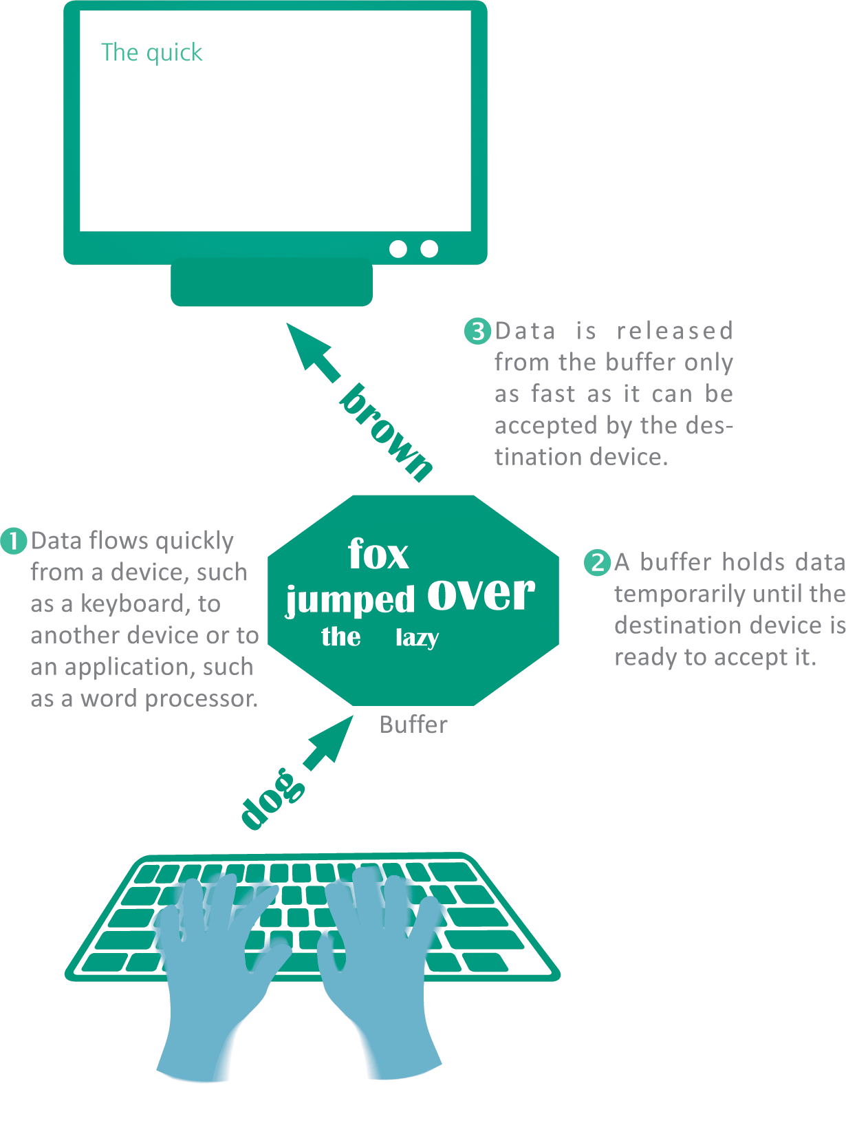
Operating System Basics (13 of 13)
An OS ensures that input and output proceed in an orderly manner, using buffers to collect and hold data while the device is busy with other tasks

Slide 45
Microsoft Windows (1 of 7)
Microsoft Windows is installed on more than 80% of the world’s personal computers
The Windows OS got its name from the rectangular work areas displayed on its screen-based desktop
Windows evolved from a Microsoft OS called DOS (Disk Operating System) that was designed to run on early PCs with Intel or Intel-compatible microprocessors
The most recent versions of Windows are Windows 7, Windows 8, and Windows 10

Slide 46
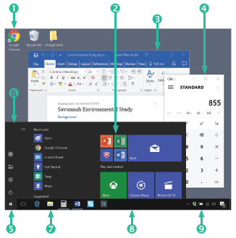
Microsoft Windows (2 of 7)
Desktop icons represent programs, folders, and data files
Tiles provide quick access to apps.
An application window displays a program

Slide 47
Microsoft Windows (3 of 7)
Another application window displays a calculator
The Windows Start button opens the Start menu
The Start menu provides access to frequently used applications and utilities
Application icons are “pinned” to the taskbar
The desktop taskbar contains the Start button, pinned icons, and the notification area
The notification area displays status icons

Slide 48
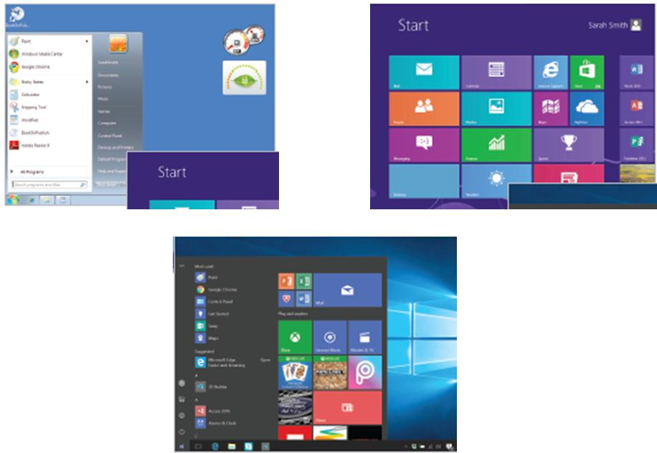
Microsoft Windows (4 of 7)

Slide 49
Microsoft Windows (5 of 7)
Windows 7 was released in 2009. It features a round Start button that produces a Search box and a Start menu for launching applications and utilities. Desktop icons provide an alternative way to access applications
Windows 8 was released in 2012. It has no Start button. Instead, colorful tiles provide access to programs and utilities. A Search box appears when any key is pressed
Windows 10 was released in 2015 after Microsoft decided to skip Windows 9. The Start button is again a prominent element of the taskbar. The desktop includes a Search box, a list of frequently used applications, and a set of tiles for accessing applications

Slide 50
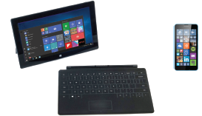
Microsoft Windows (6 of 7)
Microsoft offers several editions of Windows designed for desktop and laptop computers
All editions of Windows 10 include a Tablet Mode designed to work on tablets and laptops with touchscreens. For smartphones with ARM processors, Microsoft offers Windows 10 Mobile

Slide 51
Microsoft Windows (7 of 7)
The number and variety of programs that run on Windows are unmatched by any other operating system
Microsoft’s official site, www.microsoft.com, includes thousands of pages of easily searchable information
Windows tends to become unstable with more frequency than other operating systems
Of the major desktop operating systems, Windows has the reputation for being the most vulnerable to viruses, worms, and other attacks
One reason for Windows’ vulnerability is its huge user base, which makes it the biggest target for hackers

Slide 52
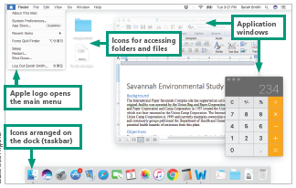
macOS (1 of 4)
As a desktop operating system, macOS features beautifully designed icons and multiple rectangular work areas to reflect multitasking capabilities.

Slide 53
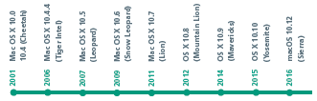
macOS (2 of 4)
In 2012, Apple released OS X 10.8 and officially dropped “Mac” from the operating system’s name
With the release of Sierra in 2016, the operating system was renamed macOS

Slide 54
macOS (3 of 4)
MacOS has a reputation for being an easy-to-use, reliable, and secure operating system
MacOS uses a kernel based on UNIX, a server operating system that includes industrial-strength memory protection features that contribute to a low incidence of errors and glitches

Slide 55
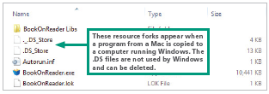
macOS (4 of 4)
Files maintained by OS X have two parts, called forks:
The data fork is similar to files in other operating systems. It contains data, such as text for a document or the commands for a program
The resource fork is a companion file that stores information about the data in the data fork, such as the file type and the application that created it

Slide 56
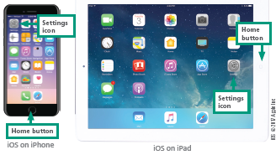
iOS (1 of 2)
iOS is a mobile operating system derived from the same UNIX code that is the basis for macOS
iOS displays a home screen containing application icons
iOS was the first operating system to offer routines to manage touchscreen gesture inputs, such as using your fingers to “squeeze” an on-screen graphic into a smaller size

Slide 57
iOS (2 of 2)
Limitations to iOS:
iOS limits your selection of apps to those provided by the online Apple App Store, unless you make unauthorized modifications to “jailbreak” the phone
Background processes, such as music, voice calls, and notifications, provide very limited multitasking capabilities

Slide 58
Android (1 of 2)
Developed in 2007, Android is a mobile operating system that is a popular platform for tablet computers, smartphones, and ebook readers
Android devices have a screen-based home button rather than a physical button
In addition to touchscreen input, the Android OS supports voice input for Google searching, voice dialing, navigation, and other applications

Slide 59
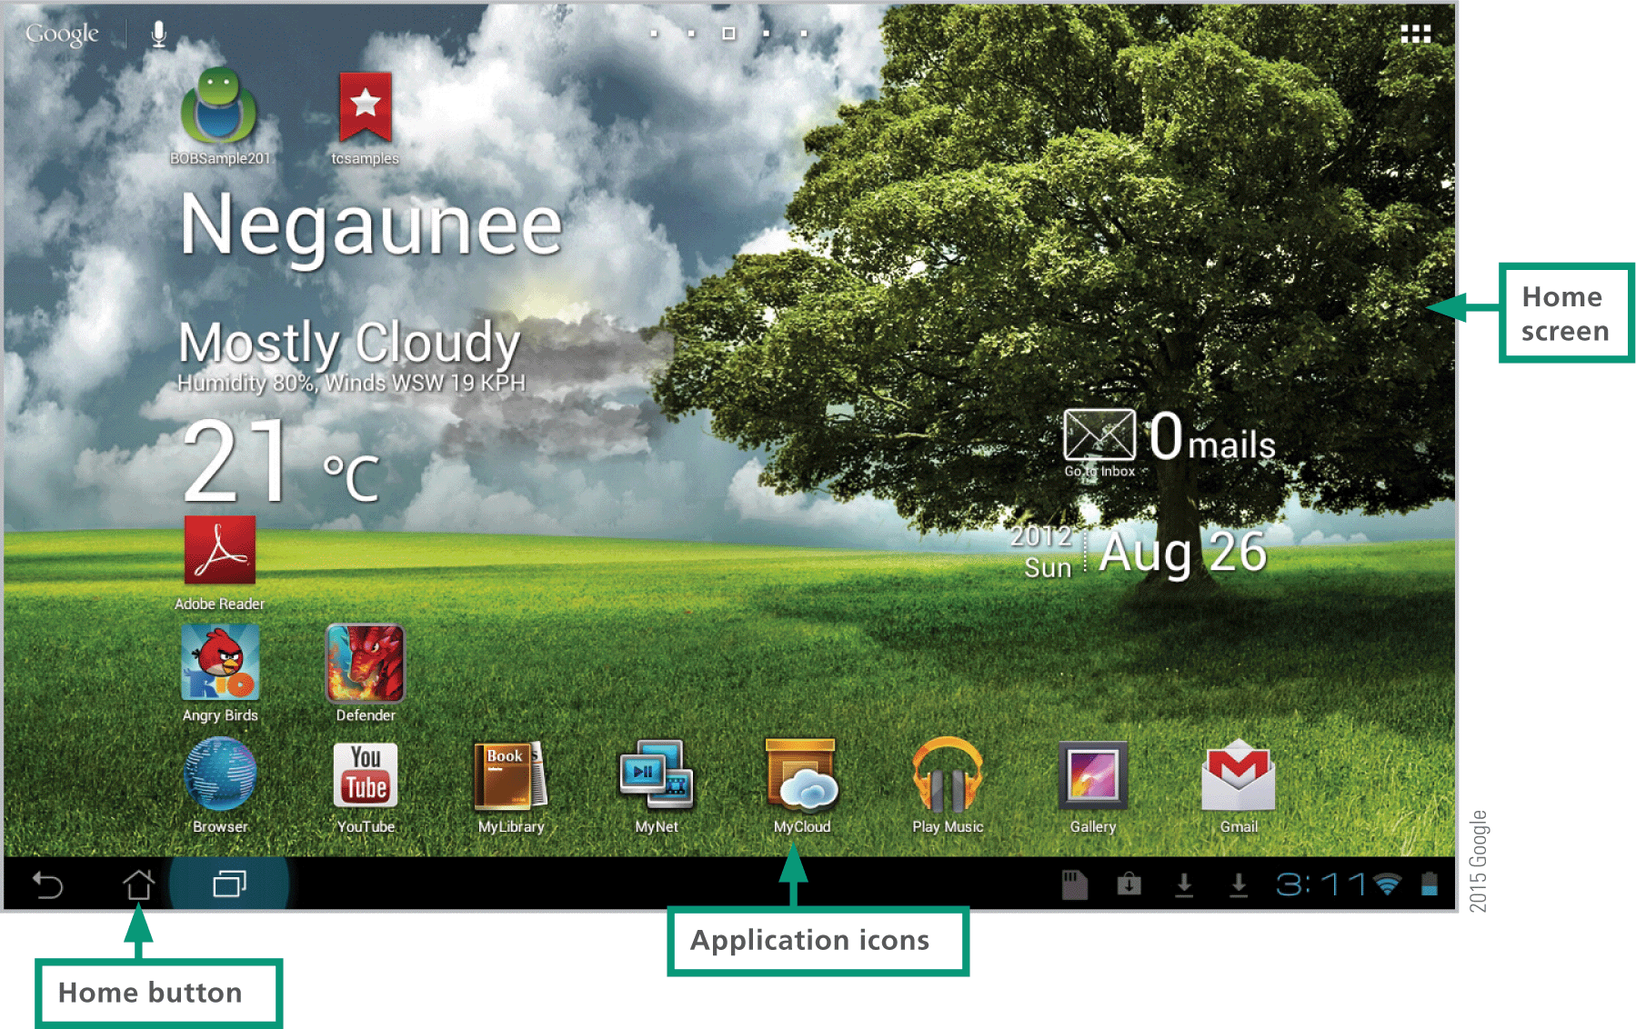
Android (2 of 2)

Slide 60
Chrome OS (1 of 2)
Google launched an OS called Chrome OS in 2009 with a kernel based on an open source OS called Linux
Chrome OS is an example of a thin client because it depends substantially on processing and storage provided by a remote computer—in this case, cloud-based servers
Unlike iPads, Chromebooks support multiple users, but provide limited storage space
Chromebooks boot very quickly to a simple desktop where apps are displayed in the Chrome browser

Slide 61
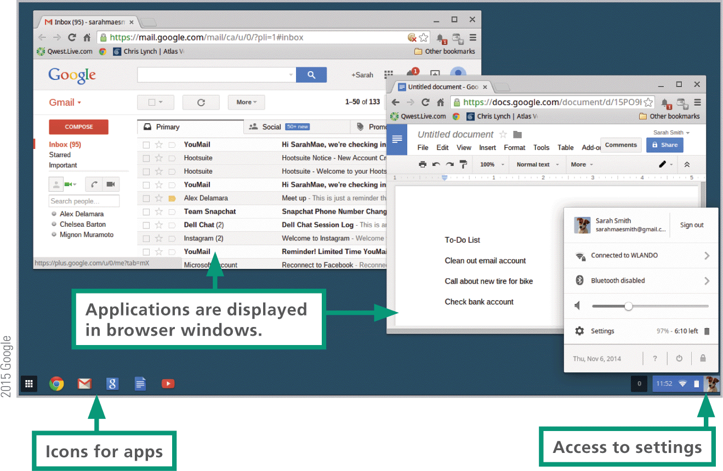
Chrome OS (2 of 2)

Slide 62
LINUX (1 of 3)
In 1991, a young Finnish student named Linus Torvalds developed the Linux (pronounced “LIH nucks”) operating system
Linux was inspired by and loosely based on a UNIX derivative called MINIX, created by Andrew Tanenbaum
As an operating system, Linux is unique because it is distributed along with its source code under the terms of a GPL (General Public License), which allows everyone to make copies for their own use, to give to others, or to sell

Slide 63
LINUX (2 of 3)
Linux users can select from a long list of system utilities for file management, packaged to meet the needs of various businesses and industries
Linux requires more tinkering than the Windows and Mac operating systems
A Linux distribution is a download that contains the Linux kernel, system utilities, desktop user interface, applications, and an installation routine. Beginner-friendly Linux distributions include Arch, Fedora, Ubuntu, Debian, openSUSE, and Mint

Slide 64
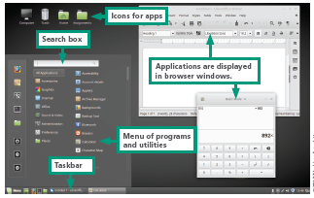
LINUX (3 of 3)

Slide 65
Virtual Machines (1 of 2)
It’s possible to run Windows on a Mac using a virtual machine
A virtual machine (VM) allows one computer to simulate the hardware and software of another
Each VM has its own simulated processor, RAM, video card, input and output ports, and OS
Popular VM software such as Vmware workstation and Parallels Desktop can run on most computers with Intel microprocessors, including Intel Macs, PCs, and generic Linux computers

Slide 66
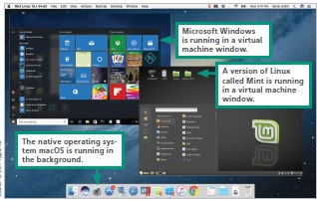
Virtual Machines (2 of 2)

Slide 67
Section C: Apps and Applications
Web Apps
Mobile Apps
Local Applications
Uninstalling Software

Slide 68
Section C: Objectives
Describe two ways in which Web apps differ from mobile apps.
List four advantages and three disadvantages of Web apps
Describe the installation process for mobile apps
Explain why iPhone owners might want to jailbreak their devices
State whether the following file extensions are associated with PCs or Macs: .exe, .app, .dll, .dmg
List the seven activities that take place during the installation process for PC software
Describe the process for installing software on Macs
Summarize the different procedures necessary to uninstall software on PCs and Macs

Slide 69
Web Apps (1 of 3)
A Web application (or Web app) is software that is accessed with a Web browser
Web apps are an example of cloud computing
Some popular Web apps include: Gmail, Google Docs, and Turnitin
Most Web apps require no installation at all on your local computer or handheld device

Slide 70
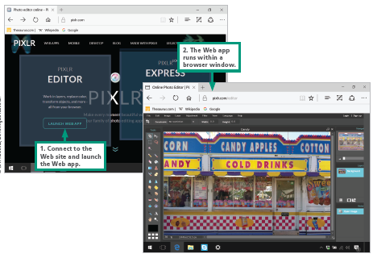
Web Apps (2 of 3)

Slide 71
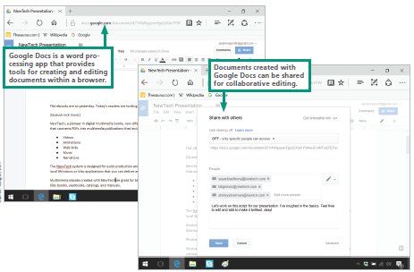
Web Apps (3 of 3)
Web apps allow several people to collaborate on projects because the project files are stored on the Web and can be easily shared

Slide 72
Web Apps - Advantages
You can access Web apps from any device that has a browser and an Internet connection, including full-size computers, smartphones, tablet computers, and enhanced media players
Your data is usually stored on the app’s web site, so you can access data even when you are away from your main computer
Web apps are always up to date; you don’t have to install updates because the latest version is the one posted at the Web site where you access the app
Web apps don’t require local storage space, so you don't have to worry about them accumulating on your hard disk or SSD

Slide 73
Web Apps - Disadvantages
Web apps tend to have fewer features than applications that require installation
If the site hosting the app shuts down, you will not be able to access the application or your data
Your data might be more vulnerable to exposure or loss because it is out of your control. If possible, back up data to a local device or to an auxiliary cloud storage site

Slide 74
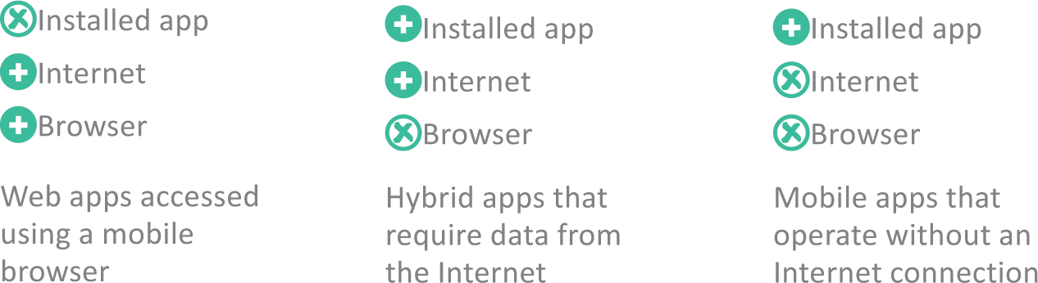
Mobile Apps (1 of 3)
A mobile app is designed for a handheld device, such as a smartphone, tablet computer, or enhanced media player
Most handheld devices can use both Web apps and mobile apps
Some apps, such as Yelp and Pandora, are hybrids; a thin client is downloaded from an app store, but during use, data is accessed from the Web

Slide 75
Mobile Apps (2 of 3)
A mobile app is designed for a handheld device, such as a smartphone, tablet computer, or enhanced media player
iPads, iPhones, and iPods are only allowed to download apps from the official iTunes App Store
Apps are available from other sources, but using them requires an unauthorized change to the device’s software called a jailbreak

Slide 76
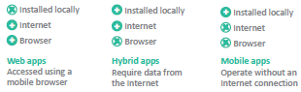
Mobile Apps (3 of 3)
After downloading and installing the jailbreak software, your device will be able to install apps from a variety of sources other than the iTunes App Store
The process of making unauthorized modifications to any mobile device is called rooting

Slide 77
Local Applications (1 of 9)
A local application is installed on a computer’s hard disk
Office suites, games, and professional software tools are common examples of local applications for desktop and laptop computers

Slide 78
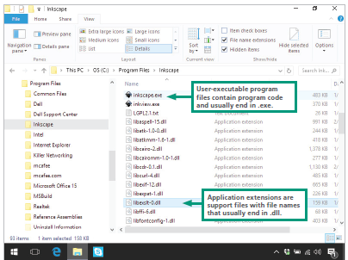
Local Applications (2 of 9)
Software designed for computers that run Microsoft Windows is commonly composed of multiple files. The main executable file has an .exe extension—for example, Inkscape.exe
Additional files required for Windows application software contain support modules called application extensions with file names that end in .dll

Slide 79
Local Applications (3 of 9)
Software for PCs contains a setup program that guides you through the installation process
During the installation process, the setup program usually performs the following activities:

Slide 80
Local Applications (4 of 9)
Copy files – Copies application files from distribution media (CDs or DVDs) or downloads files to specified folders on the hard disk
Unzip files – Reconstitutes files that have been distributed in compressed format
Check resources – Analyzes the computer’s resources, such as processor speed, RAM capacity, and hard disk capacity, to verify that they meet or exceed the minimum system requirements
Select device drivers – Analyzes hardware components and peripheral devices to select appropriate device drivers

Slide 81
Local Applications (5 of 9)
Find players – Looks for any system files and players, such as Microsoft Edge or Windows Media Player, that are required to run the program but are not supplied on the distribution media or download
Update the Registry – Updates necessary system files, such as the Windows Registry and the Start menu, with information about the new software
Update the desktop – Places an icon or tile for the new software on the Windows desktop, Start screen, or Start menu

Slide 82
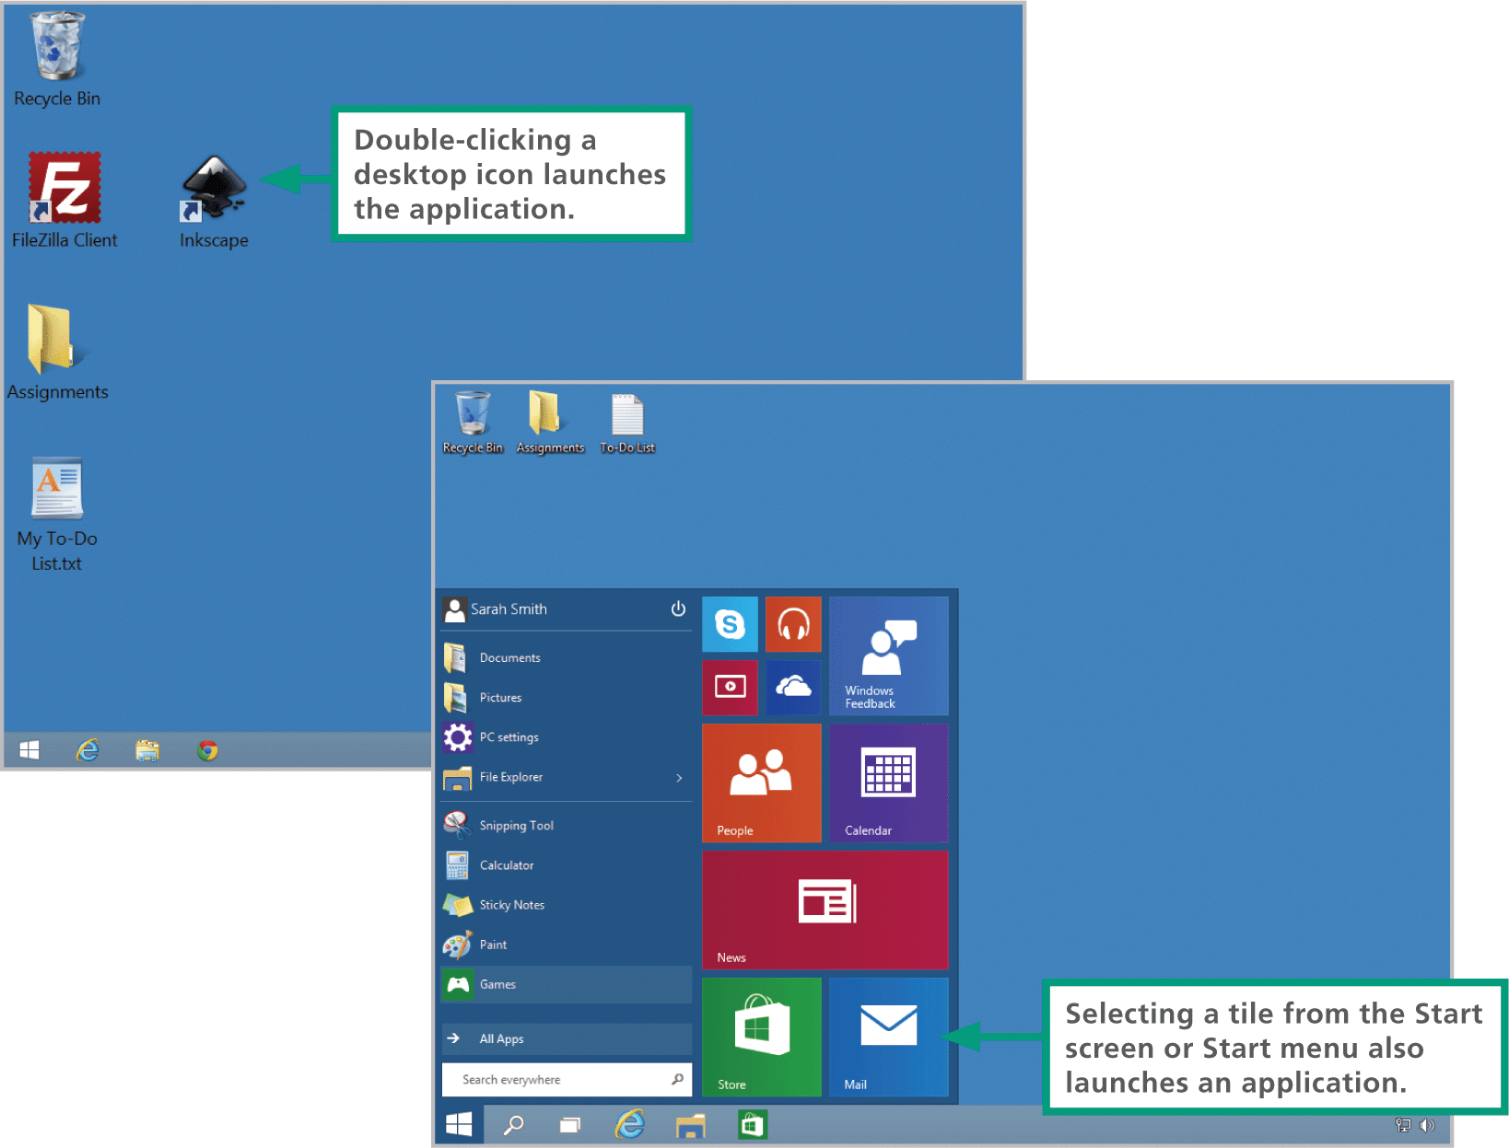
Local Applications (6 of 9)

Slide 83
Local Applications (7 of 9)
The EXE and DLL files for Windows application software are zipped to consolidate them into one large file, which is compressed to decrease its size and reduce the download time
Downloaded files are generally stored in the Downloads folder
If your computer’s hard drive malfunctions, you can use these files to rebuild your software collection without having to download all of it again

Slide 84
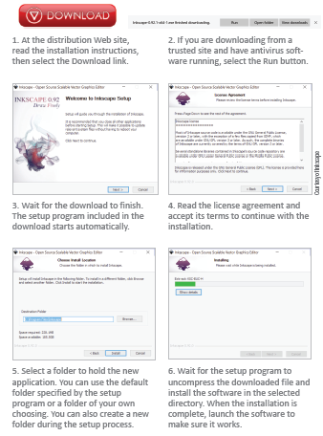
Local Applications (8 of 9)

Slide 85
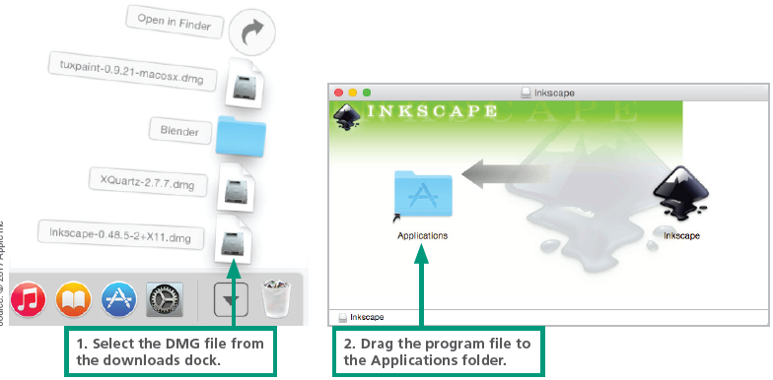
Local Applications (9 of 9)
Downloads are ordinarily supplied as a DMG package commonly referred to as a “disk image”
The DMG package has a .dmg extension

Slide 86
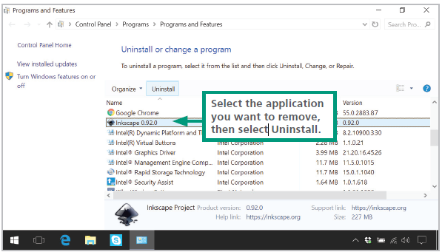
Uninstalling Software
The process of removing software differs for PCs and Macs
Most Mac users simply use Finder to locate the program’s APP file or folder and move it to the trash
The Windows OS includes an uninstall utility, which deletes the software’s files from various folders on your computer’s hard disk

Slide 87
Section D: Productivity Software (1 of 2)
Office Suite Basics
Word Processing
Spreadsheets
Databases
Presentations

Slide 88
Section D: Productivity Software (2 of 2)
List three applications that are the core of an office suite
Describe three features of word processing software that help improve the quality of writing and three features that improve the format of documents
Provide an example of a what-if analysis
Give an example of a spreadsheet formula that uses mathematical operators and cell references
Describe a formula that requires an absolute reference
Identify fields and records in a database table
Provide an example of a database that would have two or more related tables
List five commonly used features of presentation software

Slide 89
Office Suite Basics (1 of 2)
Office suites, such as Microsoft Office and Google Docs, are sometimes referred to as productivity software
An office suite is a collection of programs that typically include word processing, spreadsheet, and presentation modules
In the context of office suites, the term module refers to a component, such as a word processing module

Slide 90
Office Suite Basics (2 of 2)
NAME | MODULES | PLATFORM
Google Docs | Word processing, spreadsheet, presentation | Online(free)
iWork | Word processing, spreadsheet, presentation | macOS($$)
LibreOffice | Word processing, spreadsheet, presentation, database, drawing | Windows, macOS, Linux(Free)
Microsoft Office | Word processing, spreadsheet, presentation, database, mail/calendar | Windows, macOS, Linux, iOS, Android($$)
Zoho Office Suite | Word processing, spreadsheet, presentation,calender,and more | Online(free)

Slide 91
Word Processing (1 of 4)
Word processing software has replaced typewriters for producing many types of documents, including reports, letters, memos, papers, and book manuscripts
A typical word processor window displays a work area, called a workspace, that represents a blank piece of paper; the window also includes controls for viewing and formatting the document

Slide 92
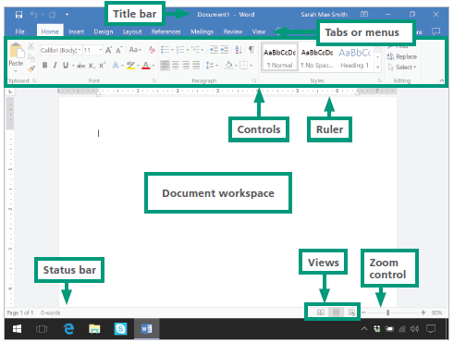
Word Processing (2 of 4)

Slide 93
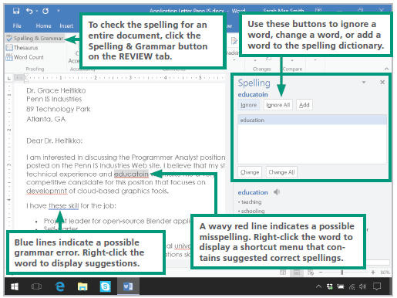
Word Processing (3 of 4)

Slide 94
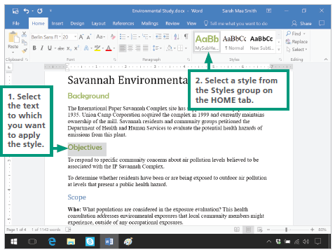
Word Processing (4 of 4)

Slide 95
Spreadsheets (1 of 6)
A spreadsheet uses rows and columns of numbers to create a model or representation of a real situation
Spreadsheet software, such as Microsoft Excel and Google Docs Sheets, provides tools to create electronic spreadsheets
Because it is so easy to experiment with different numbers, spreadsheet software is particularly useful for what-if analysis

Slide 96
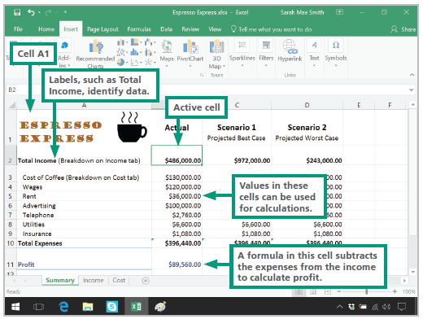
Spreadsheets (2 of 6)

Slide 97
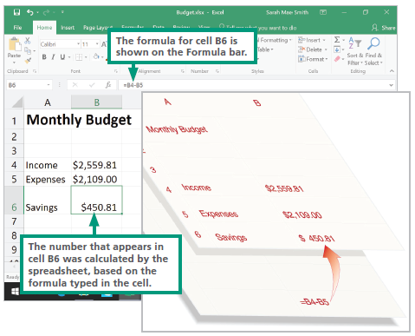
Spreadsheets (3 of 6)

Slide 98
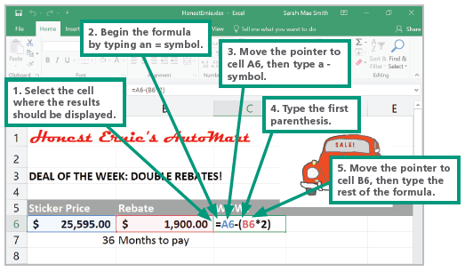
Spreadsheets (4 of 6)

Slide 99
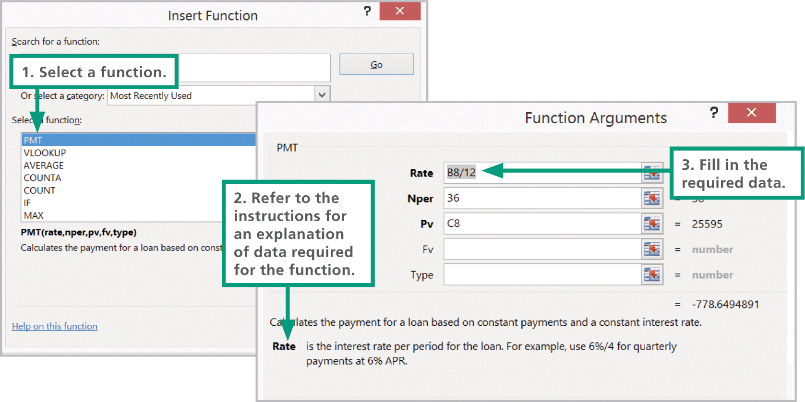
Spreadsheets (5 of 6)

Slide 100
Spreadsheets (6 of 6)
When you change the contents of any cell in a worksheet, all the formulas are recalculated; this automatic recalculation feature ensures that the results in every cell are accurate for the information currently entered in the worksheet
Unless you specify otherwise, a cell reference is a relative reference—that is, a reference that can change
An absolute reference never changes when you insert rows, or copy and move formulas

Slide 101
Databases (1 of 4)
The term database has evolved from a specialized technical term into a part of our everyday vocabulary
In the context of modern usage, a database is simply a collection of data that may be stored on one or more digital devices
Database software helps you enter, find, organize, update, and report information stored in a database
Database software stores data as a series of records, which are composed of fields that hold data
A record holds data for a single entity—a person, place, thing, or event
A field holds one item of data relevant to a record

Slide 102
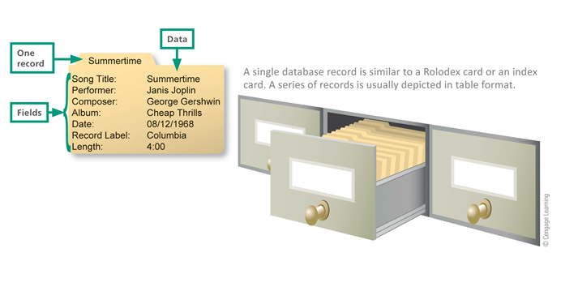
Databases (2 of 4)

Slide 103
Databases (3 of 4)
A Series of records in table format
SONG TITLE | PERFORMER | COMPOSER | ALBUM | DATE | LABEL | LENGTH
Take it Back | Norah Jones | Jones | Little Broken Hearts | 05/01/2012 | Blue Note | 4:05
Even Though | Norah Jones | Jones and Harris | The Fall | 11/07/2009 | Blue Note | 3:52
Summertime | Janis Joplin | Gershwin | Cheap Thrills | 08/12/1968 | Columbia | 4:00
Summertime | Sarah Vaughan | Gershwin | Compact Jazz | 06/22/1987 | PolyGram | 4:34

Slide 104
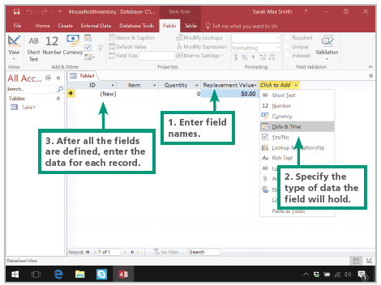
Databases (4 of 4)

Slide 105
Presentations (1 of 3)
Presentation software supplies the tools for combining text, photos, clip art, graphs, animations, and sound into a series of electronic slides that can be shown on a screen or projector
Popular presentation software products include Microsoft PowerPoint, iWork Keynote, LibreOffice Impress, and Google Docs Slides

Slide 106
Presentations (2 of 3)
Presentation software highlights include:
Bulleted lists to summarize the points in your presentation
Graphics to make your presentation visually interesting
Transitions between slides to keep your audience’s attention
Speaker notes to help you remember what to say
Themes and templates to give your slides a professional appearance
Conversion routines to package presentations as PDF files and YouTube videos

Slide 107
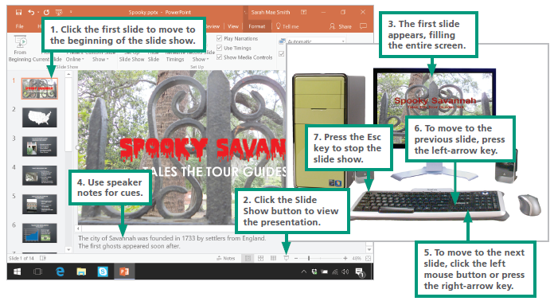
Presentations (3 of 3)

Slide 108
Section E: File Management Utilities
File Basics
File Management Tools
Application-Based File Management
Physical File Storage

Slide 109
Section E: Objectives (1 of 2)
List five file-naming conventions
Explain how storage devices on PCs are named or designated by device letters
Identify disk partitions
Write out the complete file path for any file that exists on a digital storage device
Identify the basic elements of Windows File Explorer and macOS Finder
Explain how operating systems use default applications

Slide 110
Section E: Objectives (2 of 2)
State the difference between a physical storage model and a logical storage model
Describe why an operating system uses an index file
Explain what the operating system does when you move a file to the Recycle Bin and when you permanently delete a file

Slide 111
File Basics (1 of 6)
As you learned in Unit 1, a computer file—or simply a file—is defined as a named collection of data that exists on a storage medium, such as a hard disk, cloud drive, or USB flash drive
When saving a file, you must provide a valid file name that adheres to specific rules, referred to as file-naming conventions, which include:
Maximum length is 256 characters
Symbols are not allowed
No reserved words, such as Aux, Com1, and Nul
Case is disregarded
Spaces are allowed

Slide 112
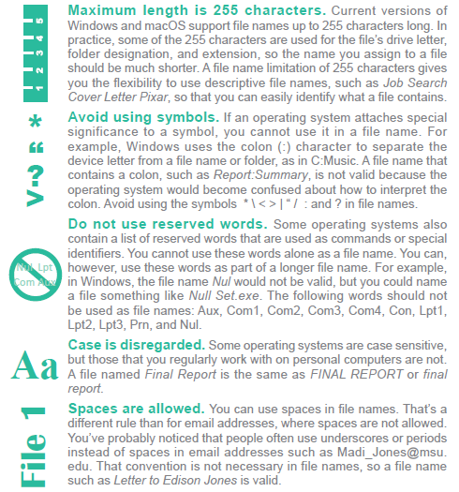
File Basics (2 of 6)

Slide 113
File Basics (3 of 6)
When working with Windows, storage devices—where files can be saved—can also be identified by a device letter
A disk partition is a section of a hard disk drive that is treated as a separate storage unit. Most hard drives are configured with a single apartition that contains the OS, programs, and data

Slide 114
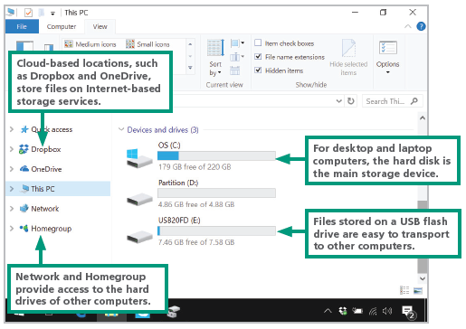
File Basics (4 of 6)

Slide 115
File Basics (5 of 6)
Every storage device has a directory containing a list of its files
The main directory is referred to as the root directory
A root directory can be subdivided into smaller lists; each list is called a subdirectory
Each subdirectory is depicted as a folder
A computer file’s location is defined by a file path, which on a PC includes the drive letter, folder(s), file name, and extension

Slide 116
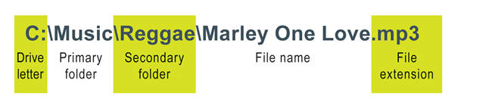
File Basics (6 of 6)
TYPE OF FILE | EXTENSIONS
Text | .txt .dat .rtf .docx(Microsoft Word) .doc(Microsoft Word 2003) .odt(OpenDocument text) .wpd(WordPerfect) .pages(iWork)
Sound | .wav .mid .mp3 .m4p .aac
Graphics | .bmp .tif .wmf .gif .jpg .png .eps .ai(Adobe Illustrator)
Animation/video | .flc .swf .avi .mpg .mp4 .mov(QuickTime) .wmv(Windows Media Player)
Web page | .htm .html .asp .vrml .php
Spreadsheet | .xlsx(Microsoft Excel) .xls(Microsoft Excel 2003) .ods(OpenDocument spreadsheet) .numbers(iWork)
Database | .accdb(Microsoft Access) .odb(OpenDocument database)
Miscellaneous | .pdf(Adobe Acrobat) .pptx(Microsoft Powerpoint) .qxp(QuarkXPress) .odp(OpenDocument presentations) .zip(WinZip) .pub(Microsoft Publisher)

Slide 117
File Management Tools (1 of 12)
Operating systems provide file organization tools called file management utilities
Windows offers a utility called File Explorer, which is launched from the Folder icon on the taskbar
MacOS offers a utility called Finder, which is launched from the Finder icon on the dock

Slide 118
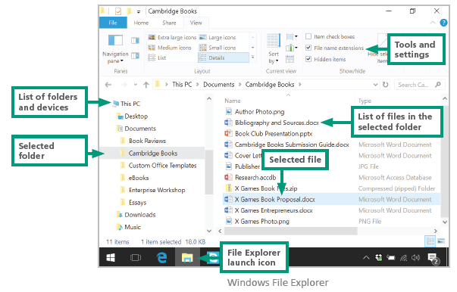
File Management Tools (2 of 12)

Slide 119
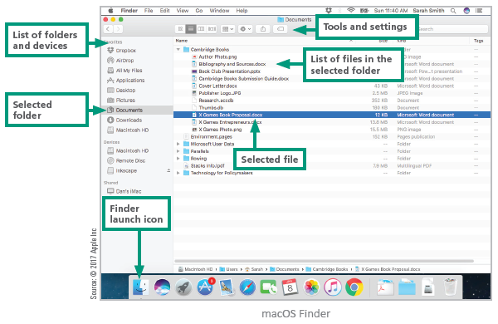
File Management Tools (3 of 12)

Slide 120
File Management Tools (4 of 12)
File management utilities are useful for locating files and for viewing their contents
The software application associated with a specific file type is called a default application
You can select the application that you want to use by right-clicking the file and selecting the application from a list

Slide 121
File Management Tools (5 of 12)
In addition to locating files and folders, file management utilities help you manipulate files and folders in the following ways:
Rename — You can change the name of a file or folder to better describe its contents.
Copy — You can copy a file from one device to another-for example, from a USB drive to the hard disk drive. You can also make a copy of a document so that you can revise the copy and leave the original intact.

Slide 122
File Management Tools (6 of 12)
Move — You can move a file from one folder to another or from one storage device to another. When you move a file, it is erased from its original location, so make sure you remember the new location of the file. You can also move an entire folder and its contents from one storage device to another storage device or to a different folder.
Delete — You can delete a file when you no longer need it. You can also delete a folder. Be careful when you delete a folder because most file management utilities also delete all the files within a folder.

Slide 123
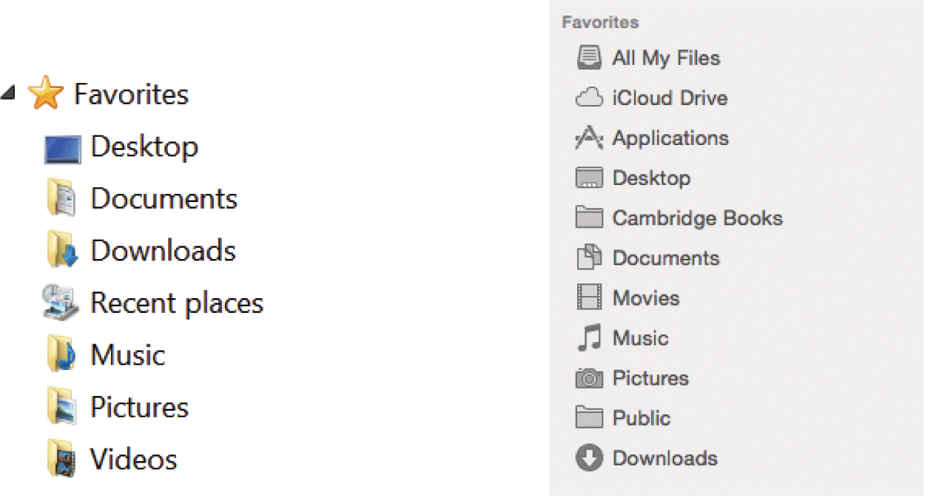
File Management Tools (7 of 12)
Windows and OS X offer a set of preconfigured personal folders, such as Documents and Music, for storing your personal data files

Slide 124
File Management Tools (8 of 12)
Use descriptive names — Give your files and folders descriptive names, and avoid using cryptic abbreviations
Maintain file extensions — When renaming a file, keep the original file extension so that it can be opened with the correct application software
Group similar files — Separate files into folders based on subject matter. For example, store your creative writing assignments in one folder and your MP3 music files in another folder

Slide 125
File Management Tools (9 of 12)
Organize your folders from the top down — When devising a hierarchy of folders, consider how you want to access files and back them up. For example, it is easy to specify one folder and its subfolders for a backup. If your important data is scattered in a variety of folders, however, making backups is more time-consuming

Slide 126
File Management Tools (10 of 12)
Consider using default folders — You should use preconfigured personal folders, such as Documents and Music, as your main data folders. Add subfolders to these personal folders as necessary to organize your files
Use public folders for files you want to share — Use the public folders for files that you want to share with other network users

Slide 127
File Management Tools (11 of 12)
Don’t mix data files and program files — Do not store data files in the folders that hold your software. Most software is stored in subfolders of the Program Files folder on Windows systems and in the Applications folder on Macs
Don’t store files in the root directory — Although it is acceptable to create folders in the root directory, it’s not a good practice to store programs or data files in the root directory of your computer’s hard disk

Slide 128
File Management Tools (12 of 12)
Access files from the hard disk. For best performance, copy files from USB drives to your computer’s hard disk before accessing them
Follow copyright rules. When copying files, make sure you adhere to copyright and license restrictions
Delete or archive files you no longer need. Deleting unneeded files and folders helps keep your list of files from growing to an unmanageable size
Be aware of storage locations. When you save files, be sure to specify the correct storage device and folder
Back up! Back up your folders and files regularly

Slide 129
Application-Based File Management (1 of 2)
Applications, such as Word and Excel, generally provide a way to open files and save them in a specific folder on a designated storage device
Saving files is easy; simply use the Save option provided by your application, specify a location for the file, and give it a name

Slide 130

Application-Based File Management (2 of 2)

Slide 131
Physical File Storage (1 of 2)
The structure of files and folders displayed by File Explorer is called a logical storage model because it helps you create a mental picture of the way files are organized in a hierarchy of folders
A physical storage model describes what actually happens on the disks and in the circuits
The formatting process creates the equivalent of electronic storage bins
Magnetic and optical media are divided into circular tracks and then further divided into pie-shaped sectors

Slide 132
Physical File Storage (2 of 2)
The OS uses a file system to keep track of the names and locations of files that reside on a storage medium, such as a hard disk
To speed up the process of storing and retrieving data, a disk drive usually works with a group of sectors called a cluster or a block
To delete data from a disk in such a way that no one can ever read it, you can use a special file shredder software that overwrites supposedly empty sectors with random 1s and 0s; this is handy if you want to sell or donate your computer and want to make sure your personal data is no longer on the hard disk

